Slide 1

LASER SECURITY ALARM SYSTEM USING ARDUINO
DIGITAL LOGIC AND CIRCUITSAmerican International University- Bangladesh
DIGITAL LOGIC AND CIRCUITSMICROPROCESSOR AND EMBEDDED SYSTEM[G]
Supervisor,
SUJJAN HOWLADER

Slide 2
Names of group members
Most. sayma khatun (ID:22-47035-1)
Effat ara (ID: 22-46090-1)
Md. Abdullah shishir (ID: 22-46410-1)
Fatema akter sujana (id: 21-45693-3)
Hasibul hasan (id: 17-34505-2)

Slide 3

Contents:
INTRODUCTION
ABSTRACT
Objective
APPARATUS
CIRCUIT DIAGRAM
SIMULATION
WORKING PROCEDURE
IMPLEMENTATION
CONCLUSION

Slide 4
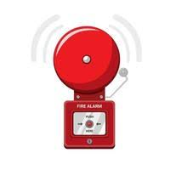
Introduction
Security stands as the paramount concern globally as technology advance.
So, security technology has to advance throughout time to defend against criminal.
Our project utilizes laser light
for extensive coverage.
Laser beams travel long distance scattering remaining visible only at source and impact.

Slide 5
Abstract
Am Arduino –based security system featuring laser technology was developed as part of a research to combat the rise in crime. It recognizes intruders when the switch is activated.

Slide 6
Objective
The primary objective of this project is to design and implement a laser security alarm system using Arduino. The aims are:
To learn the working of a laser security alarm system.
Determine the function of an Arduino, laser, and light dependent resistor
To learn how to build simple circuits.

Slide 7
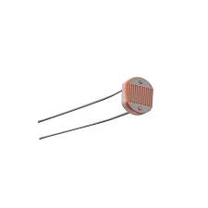
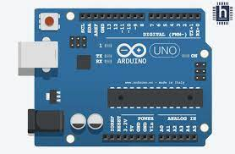
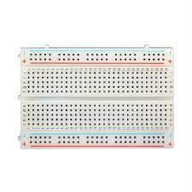
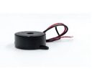

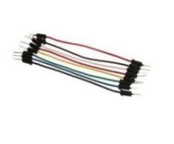
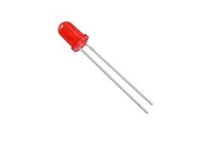

Apparatus
Arduino UNO Board
LDR
Bread Board
Buzzer
Resistor
Arduino UNO Board
LDR
Switch
Buzzer
Resistor 10 k
Bread Board
LED
Connecting Wires
Laptop
Connecting Wires
LED
Laptop

Slide 8
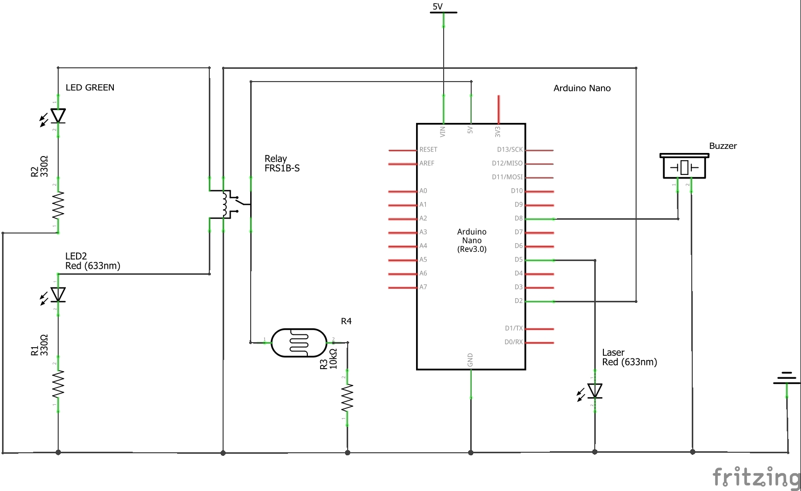
CIRCUIT DIAGRAM

Slide 9
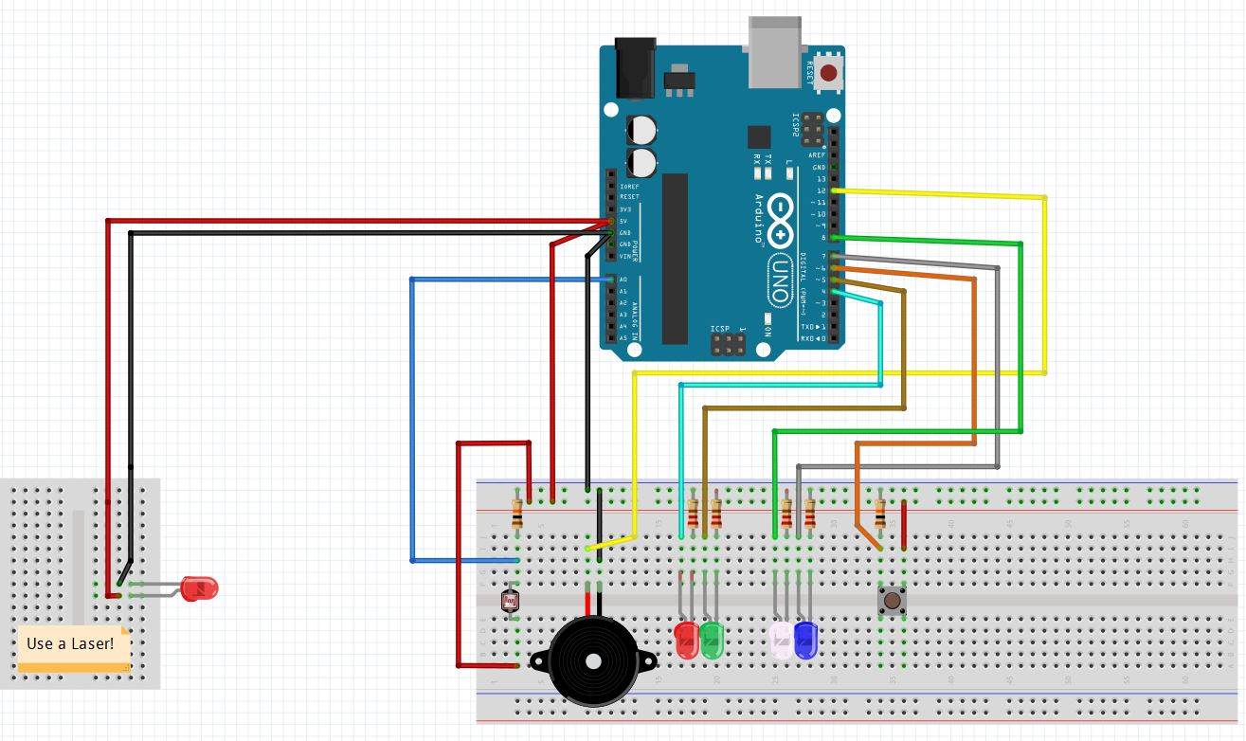
Simulation
Codes of the Program:
void setup() {
// put your setup code here, to run once:
pinMode(11,OUTPUT);//Buzzer Pin
pinMode(2,OUTPUT);
pinMode(A0,INPUT); // Light Sensor
delay(500);
Serial.begin(9600);
}
void loop() {
digitalWrite(2,HIGH);
int Read = analogRead(A0);
if(Read(< 1018) {
digitalWrite(11,HIGH);
delay(300);
digitalWrite(11,LOW);
delay(100);
}
else {
digitalWrite(11,LOW);
}
}

Slide 10
Working Procedure
In this project, we used the Laser Diode Module KY-008 to design a Laser Light Security System using Arduino with Alarm. The idea behind the project is to build a security system. The buzzer alarm will begin to ring whenever any object blocks the LASER ray.

Slide 11
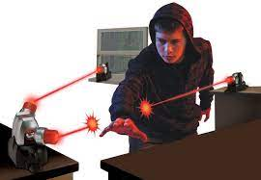
Implementation
Home Security
Workspace Security
Outdoor Security
Valuables Protection

Slide 12
Conclusion
The sector is expanding rapidly due to technological advancements and new adjustment may be made to increase its efficiency.
It can be said that this is one of the simplest model used as laser security alarm system that can be made at home with very less cost.

Slide 13
Thank YOU

